Slide 1
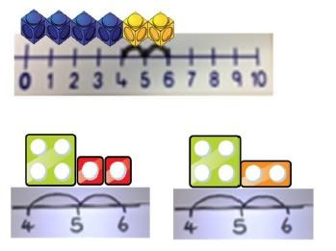
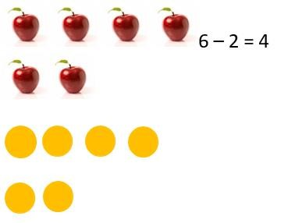
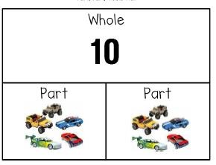
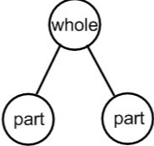
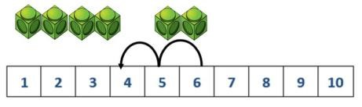
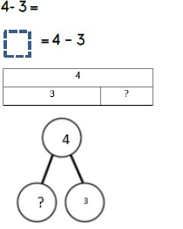
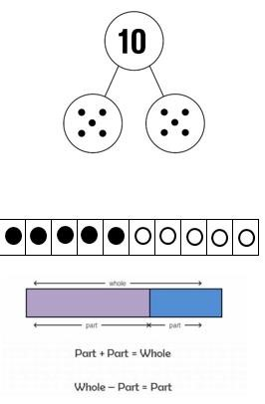
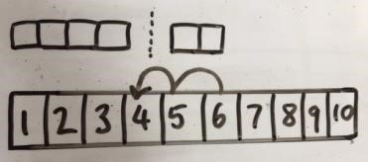


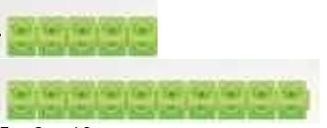

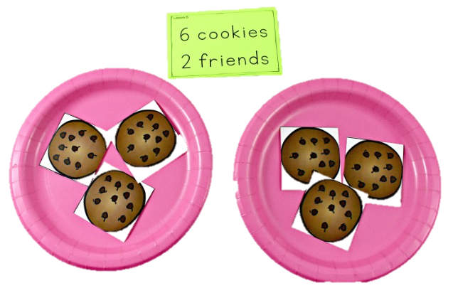
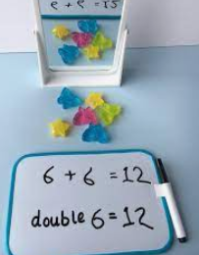
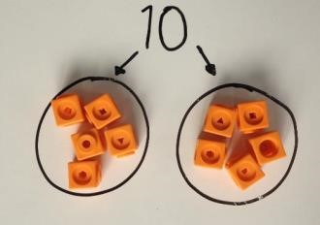
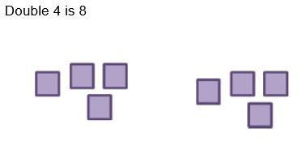
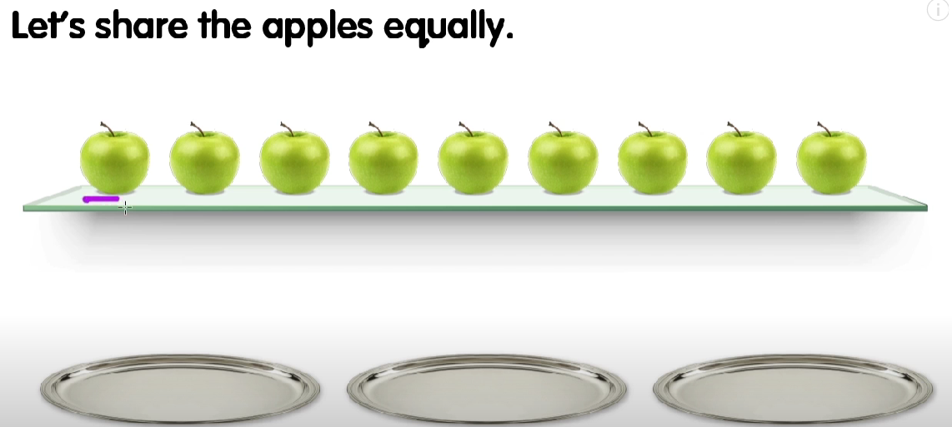
Addition
At Abbotswood, we follow the Concrete, Pictorial, Abstract (CPA) approach to the teaching and learning of Mathematics.
Subtraction
Combining 2 groups
Counting back using number lines
Jumping along a number line
Taking away ones
EYFS
Doubling
Sharing objects
Multiplication
Division

Slide 2
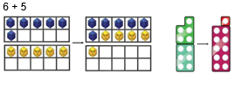
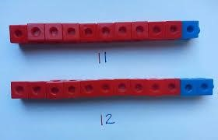
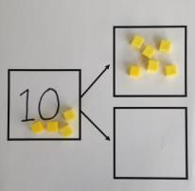




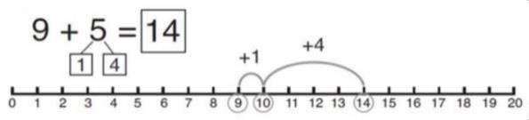
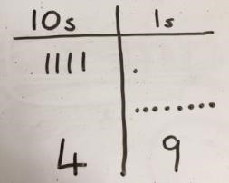
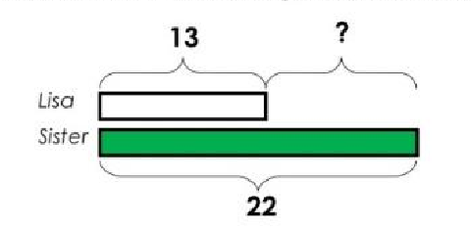
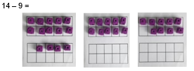
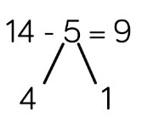

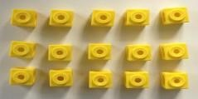

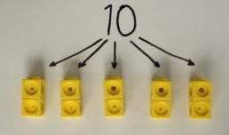
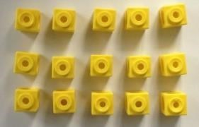
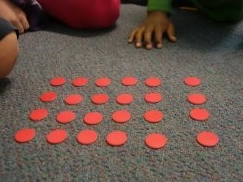
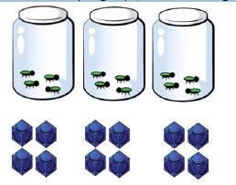


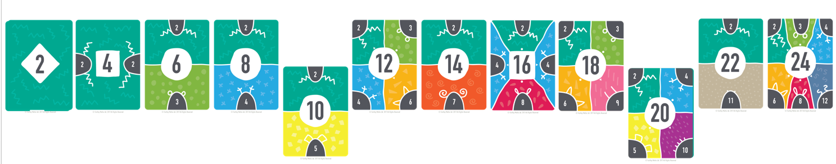
Addition
At Abbotswood, we follow the Concrete, Pictorial, Abstract (CPA) approach to the teaching and learning of Mathematics.
Subtraction
Combining 2 groups
TO + O
Finding the difference
Part – part whole model
Tens frames
Year 1
Counting in multiplies
Sharing objects
Arrays
Arrays
Repeated addition
Step counting – 2 (link to doubling and halving)
Multiplication
Division

Slide 3
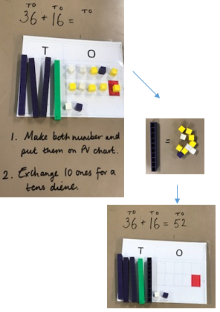
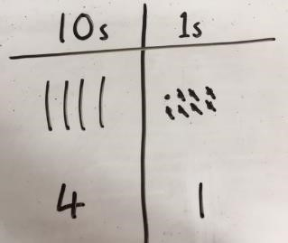
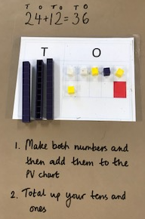
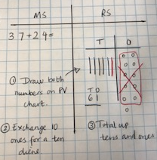
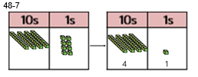
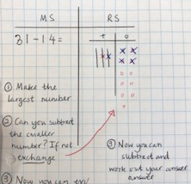
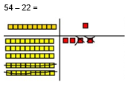
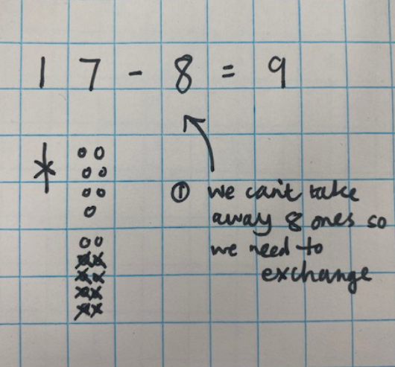
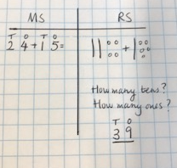
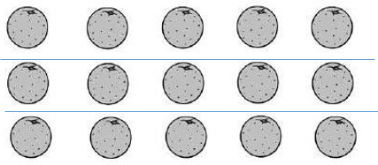
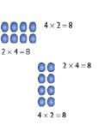
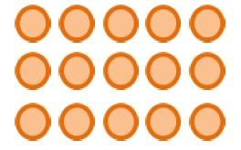


Addition
At Abbotswood, we follow the Concrete, Pictorial, Abstract (CPA) approach to the teaching and learning of Mathematics.
Subtraction
TO + TO (no regrouping)
TO + TO (regrouping)
TO – 0 and TO – TO
(no regrouping)
TO - TO (regrouping)
Year 2
Repeated addition
Arrays
Sharing objects
Step counting – 2, 5, 10
Arrays
15 = 3 × 5
5 × 3 = 15
3 + 3 + 3 + 3 + 3 = 15
15 = 5 + 5 + 5
Division with remainders - GDS
Multiplication
Division

Slide 4
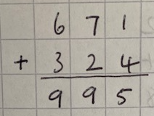
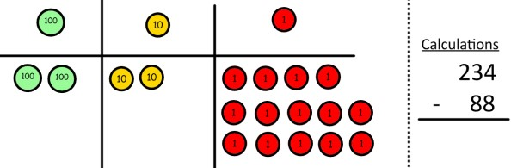
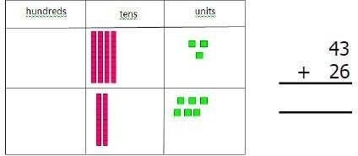
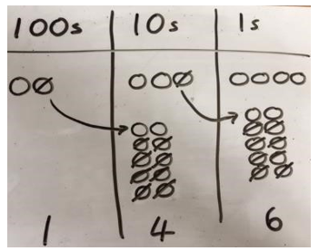
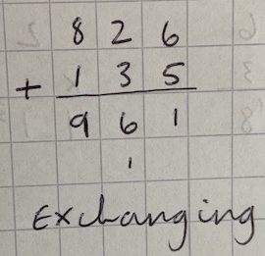
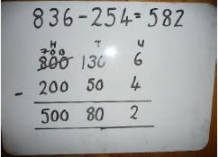
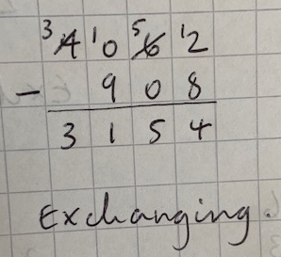
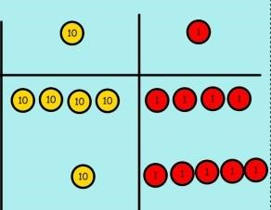
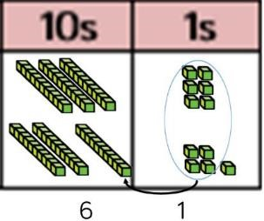
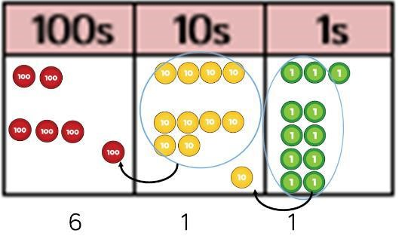








Addition
At Abbotswood, we follow the Concrete, Pictorial, Abstract (CPA) approach to the teaching and learning of Mathematics.
Subtraction
Introduce column addition
(along side pictorial representations)
Introduce column subtraction
(along side pictorial representations)
Year 3
Introduce formal ways of multiplication
(along side pictorial representations)
Short division with know facts
Grid method
15 = 3 × 5
5 × 3 = 15
3 + 3 + 3 + 3 + 3 = 15
15 = 5 + 5 + 5
Division with remainders in context
Arrays
Introduce formal ways of division
(along side pictorial representations)
Step counting – 3, 4, 8, 6
Bar model
Multiplication
Partitioning
Division

Slide 5



















Addition
At Abbotswood, we follow the Concrete, Pictorial, Abstract (CPA) approach to the teaching and learning of Mathematics.
Subtraction
Column addition
(exchanging when needed)
Subtracting fractions – Y4 onwards
Adding fractions
– Y4 onwards
Column Subtraction
(exchanging when needed)
KS2
Grid method
Formal written method
Long division
Short division
Division of fractions
Multiplying fractions – Y5 onwards
Partitioning
Multiplication
Division
Step counting

